Slide 1


Introduction to OEC Mental Care Service
Presenter: Lu YIN
OEC Mental Health Counsellor

Slide 2

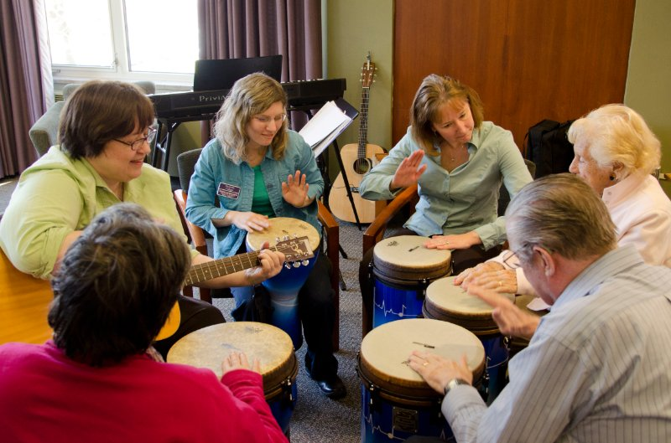

What services do we provide?
One-to-One Counselling/Psychotherapy
Group Activities/Therapy
Emotional Intelligence Education

Slide 3
One-to-One Counselling/Psychotherapy
Provided by OEC psychological counsellor.
3 ways to counsel.
Check OEC website for detailed information.
1
2
3
Drop-in Counselling Service
Writing Emails to your counsellor
Talk to your counsellor in WeChat

Slide 4

What is Counselling/Psychotherpy?
NO!
If you are mentally ill, you need to go to a mental hospital.
Does seeking counselling support mean that I am mentally ill?
Counselling is more of “talking”, while psychotherapy is more of behaviour/thoughts training.

Slide 5
What can counselling/psychotherpy help with?
It can be useful for anyone who wants to explore the way they're thinking or feeling further, as well as anyone experiencing a problem or issue they are keen to resolve. People may choose to speak to a counsellor because they feel they cannot speak to their other half/friends/family about such personal issues, or they may simply wish to speak to a professional with an objective viewpoint.
Common subjects that can be addressed within counselling include the following:
Addictions
Bereavement
Bullying
Illness
Relationships
Trauma
Other

Slide 6
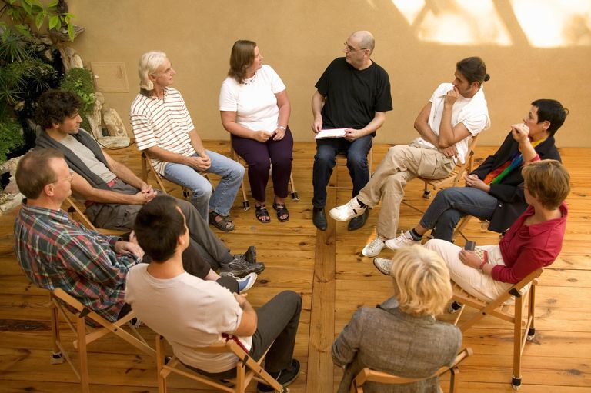
Group Therapy
Group therapy is a form of psychotherapy that involves one or more therapists working with several people (often working on the same issues) at the same time.

Slide 7
How does group therapy work?
Knowing that you are not the only one helps a lot
Giving hope
Sharing useful information
Acceptance
Socialization
And many more benefits
But in a school setting like OEC, group therapy is more of working with common issues such as dealing with study pressure, overcoming culture shock, relationship problem, or even as simple as how to feel happier.

Slide 8
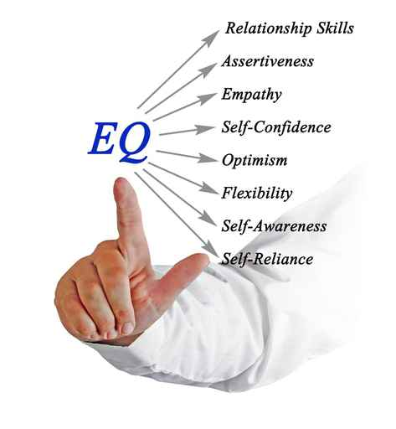
Emotional Intelligence Education
Themes
Knowing me; Knowing you
Me and my family
Making sense of my life journey
Effective listening
Understanding feelings

Slide 9
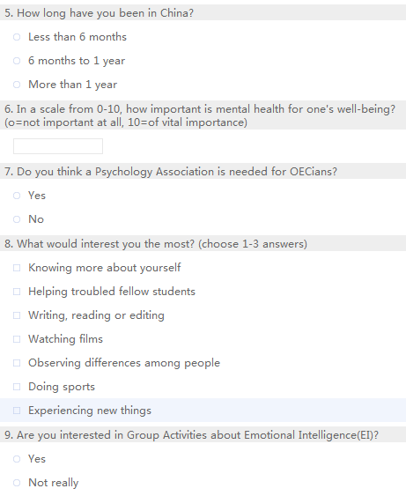
OEC appreciates your input of how to provide better mental care service
Psychology Association?
Emotional Intelligence Education topics?
OEC: Mental Care Service Survey

Slide 10

Please do not give this PPT to people who are not an OECian, Thanks:)
Lu YIN
Email:15751779723@163.com
Mobile: 15751779723

